Slide 1

The Battles of The Neighborhood
Case study of New York City

Slide 2
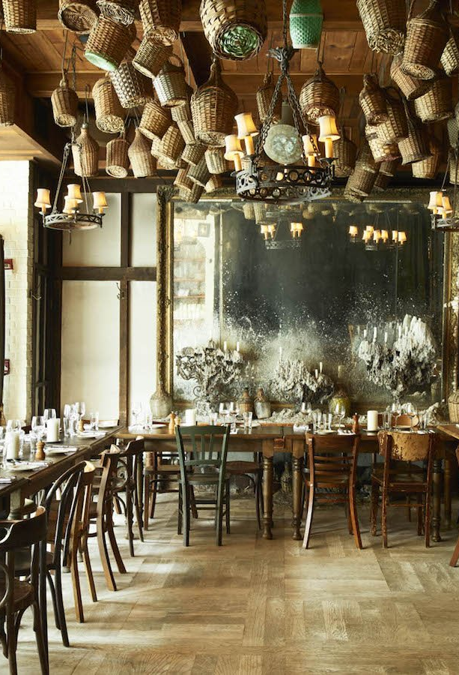
Introduction
New York city review for a Company.
AIM: Optimum location for new Restaurant business
Business Problem : - Choice of first neighborhood to start restaurant business. - Easy to replicate. - Low competition - High demand - Choice of Menu
Success Criteria : - Best neighborhood which meets above criteria.

Slide 3

New York city Facts
Most populous city in the United States
It is diverse and is the financial capital of USA
It is multicultural and Provides lot of business opportunities
Business friendly environment
Attracted many different players into the market and is global hub of business and commerce.
The city is a major center for banking and finance, retailing, world trade, transportation, tourism, real estate, new media, traditional media, advertising, legal services, accountancy, insurance, theatre, fashion, and the arts in the United States.

Slide 4
Business Environment in NEW YORK
Market is highly competitive
Highly developed city so cost of doing business is also one of the highest
New business venture or expansion needs to be analyzed carefully
One should strategically target the market in order to – -This will help in reduction of risk. -The Return on Investment will be reasonable.

Slide 5
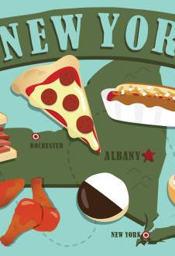
Cuisine of New York
The City of New York is famous for its excellent cuisine. Its food culture includes an array of international cuisines influenced by the city's immigrant history.
Central and Eastern European immigrants, especially Jewish immigrants - bagels, cheesecake, hot dogs, knishes, and delicatessens
Italian immigrants - New York-style pizza and Italian cuisine
Jewish immigrants and Irish immigrants - pastrami and corned beef
Chinese and other Asian restaurants, sandwich joints, trattorias, diners, and coffeehouses are ubiquitous throughout the city
Mobile food vendors - Some 4,000 licensed by the city
Middle Eastern foods such as falafel and kebabs examples of modern New York street food
Famous for fine dining Michelin starred restaurants. The city is home to "nearly one thousand of the finest and most diverse haute cuisine restaurants in the world", according to Michelin.
So it is evident that to survive in such competitive market it is very important to strategically plan.

Slide 6

Factors deciding Restaurant Location
New York Population
New York City Demographics
Are there any Farmers Markets, Wholesale markets etc. nearby so that the ingredients can be purchased fresh to maintain quality and cost?
Are there any venues like Gyms, Entertainment zones, Parks etc. nearby where floating population is high etc.
Who are the competitors in that location?
Cuisine served / Menu of the competitors
Segmentation of the Borough
Untapped markets
Saturated markets, etc.

Slide 7
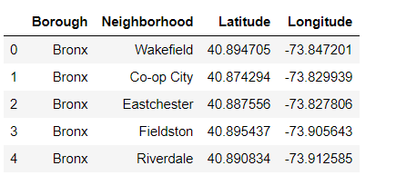
Data Description
Data 1 : Neighborhood has a total of 5 boroughs and 306 neighborhoods. In order to segment the neighborhoods and explore them, we will essentially need a dataset that contains the 5 boroughs and the neighborhoods that exist in each borough as well as the latitude and longitude coordinates of each neighborhood.
This dataset exists for free on the web. Link to the dataset is : https://geo.nyu.edu/catalog/nyu_2451_34572

Slide 8
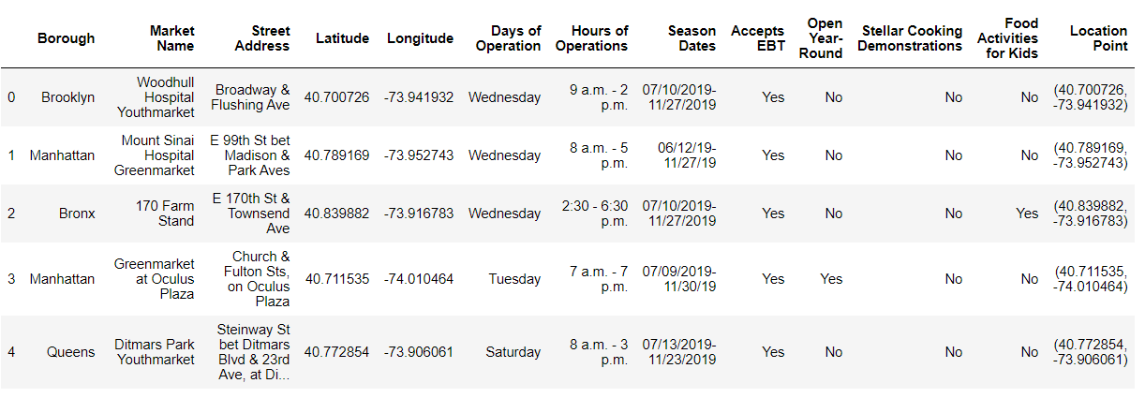
Data description (contd.)
A farmers' market is often defined as a public site used by two or more local or regional producers for the direct sale of farm products to consumers. In addition to fresh fruits and vegetables, markets may sell dairy products, fish, meat, baked goods, and other minimally processed foods.
Data 2 : Farmers Markets data - https://data.cityofnewyork.us/dataset/DOHMH-Farmers-Markets-andFood-Boxes/8vwk-6iz2

Slide 9
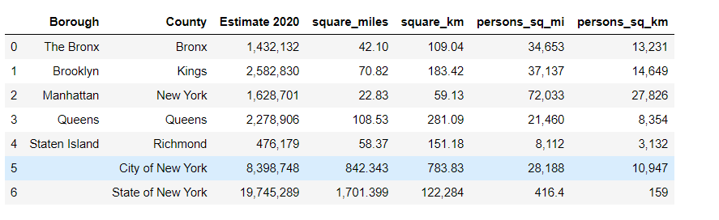
Data description (Contd.)
Data 3 : Data from Wikipedia pages as given below :
New York Population https://en.wikipedia.org/wiki/New_York_City

Slide 10
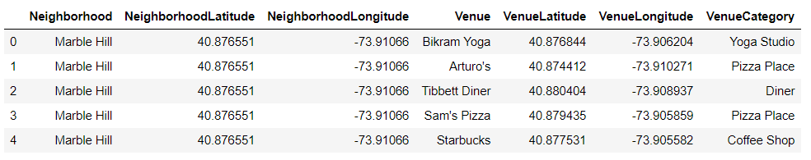
Data description (contd.)
Data from foursquare.com
New York city geographical coordinates data will be utilized as input for the Foursquare API, that will be leveraged to provision venues information for each neighborhood. We will use the Foursquare API to explore neighborhoods in New York City. The below is image of the Foursquare API data.

Slide 11
Analytical Approach
New York city neighborhood has a total of 5 boroughs and 306 neighborhoods
PART 1 - Clustering of Manhattan and Brooklyn
PART 2 - Clustering of Bronx, Brooklyn and Queens.
Only restaurant data is filtered from foursquare.com venues data and utilized for this project.
This is done because of the following Exploratory data analysis

Slide 12
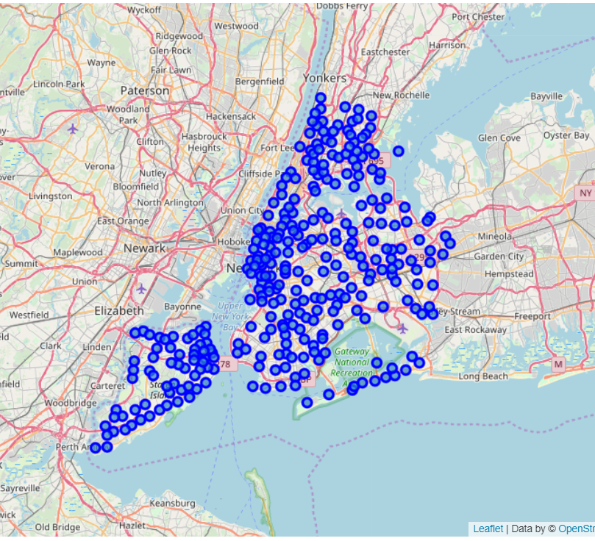
Data 1
Data 1- New York city Geographical Coordinates Data.
Load the data and explore data - newyork_data.json
Transform the data of nested python dictionaries into a pandas’ data frame.
Data frame contains the geographical coordinates of New York city neighborhoods.
Data will used to get Venues data from Foursquare.
Geopy and folium libraries used to create a map of New York city with neighborhoods superimposed on top.

Slide 13
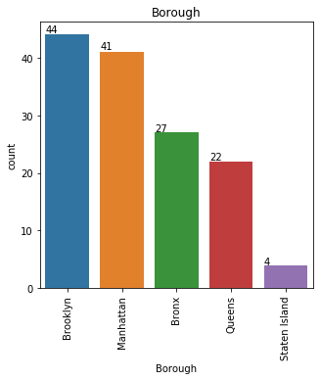
Data 2
Data 2- DOHMH Farmers Markets and Food Boxes dataset.
In this we will be using the data of Farmers Markets
There are totally 144 Farmers Markets in New York city.
Highest number are in Manhattan and Brooklyn, and lowest in Queens, Bronx and Staten Island.

Slide 14
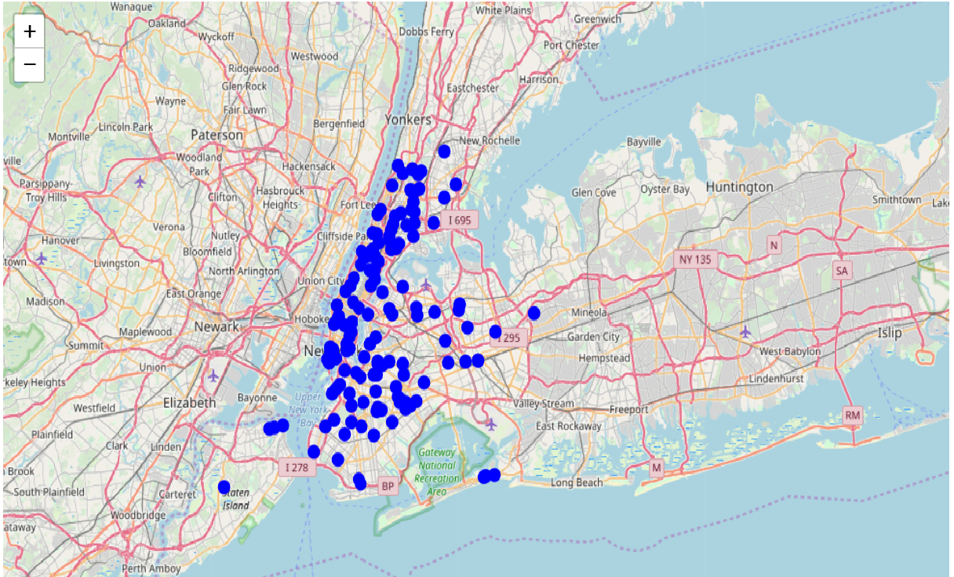
Data 2 Map Visualization

Slide 15
Data 3
Data 3 : To analyze New York city Population, scrapped the data from Wikipedia pages given above in the data section.
I used BeautifulSoup python library.
Beautiful Soup is a Python package for parsing HTML and XML documents (including having malformed markup, i.e. non-closed tags, so named after tag soup).
It creates a parse tree for parsed pa,
Manhattan (New York County) is the geographically smallest and most densely populated borough.
Manhattan's (New York County's) population density of 72,033 people per square mile (27,812/km²) in 2015 makes it the highest of any county in the United States and higher than the density of any individual American city.
Brooklyn (Kings County), on the western tip of Long Island, is the city's most populous borough.
Queens (Queens County), on Long Island north and east of Brooklyn, is geographically the largest borough. ges that can be used to extract data from HTML, which is useful for web scraping

Slide 16
Data 4
New York city geographical coordinates data has be utilized as input for the Foursquare API, that has been leveraged to provision venues information for each neighborhood.
We used the Foursquare API data to explore neighborhoods in New York City.
Using the geographical coordinates of each neighbourhood foursquare API calls are made to get top 200 venues in a radius of 1000 meters PART – 1 Brooklyn and Manhattan PART – 2 Bronx, Brooklyn and Queens

Slide 17
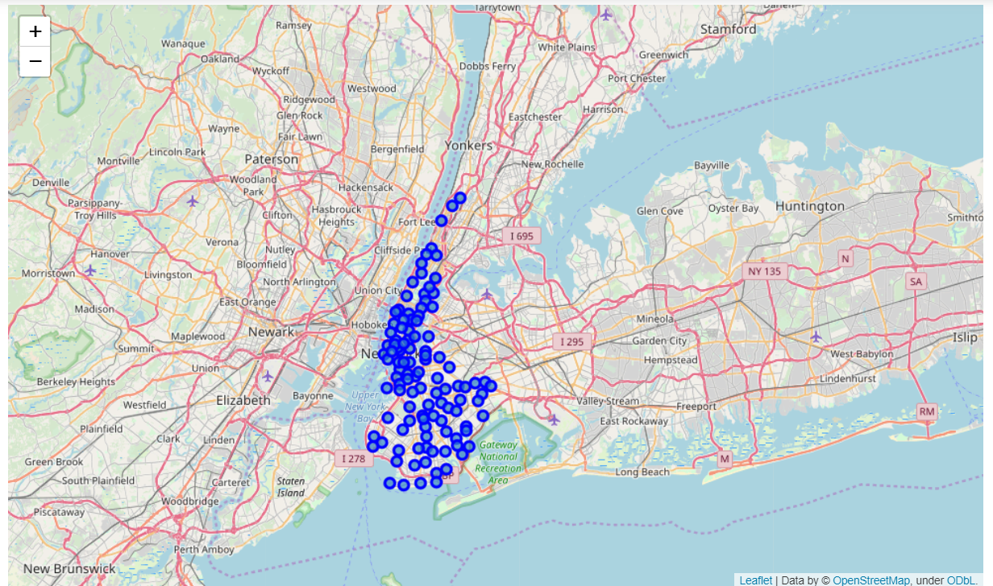
Brooklyn and Manhattan Venues Data Visualization
Visualization for Manhattan and Brooklyn

Slide 18
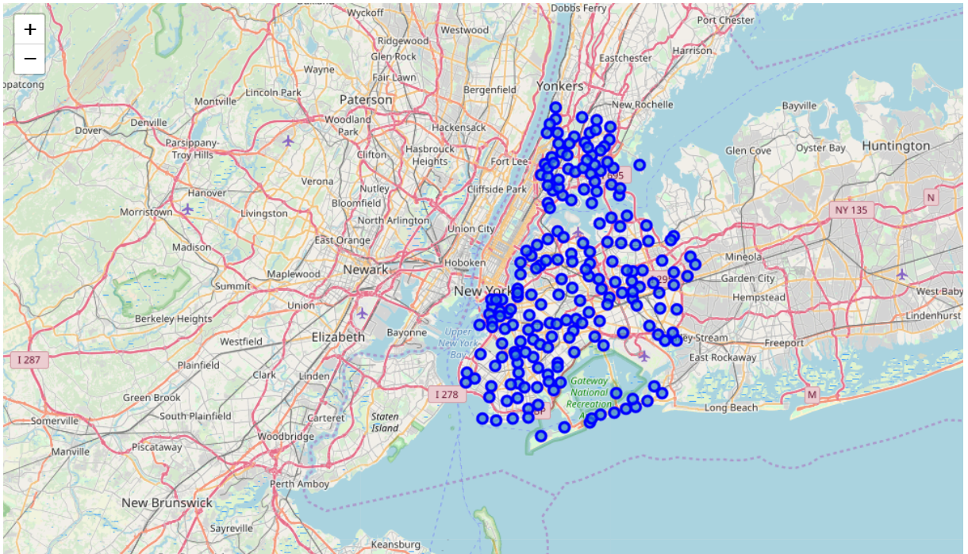
Bronx, Brooklyn and Queens visualization

Slide 19
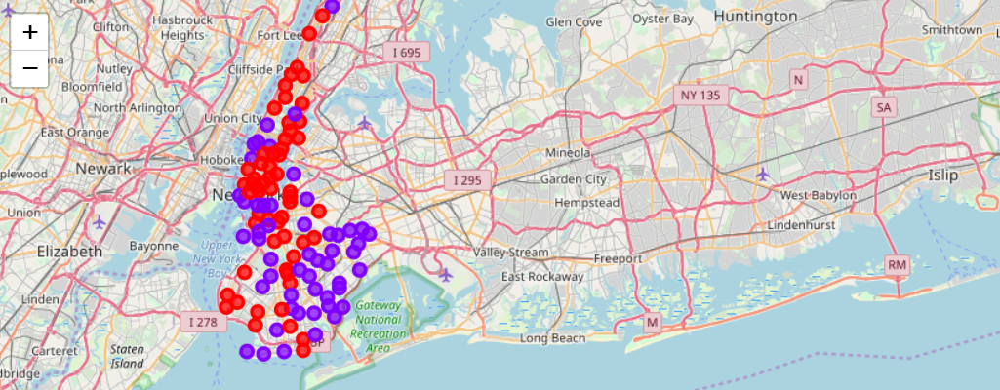
Results (Brooklyn and Manhattan)
Segmenting and Clustering Neighborhoods
Cluster0 : The Total and Total Sum of cluster0 has smallest value. It shows that the market is not saturated.
Cluster1 : The Total and Total Sum is very high. Lot of competition. Saturated neighborhoods.

Slide 20
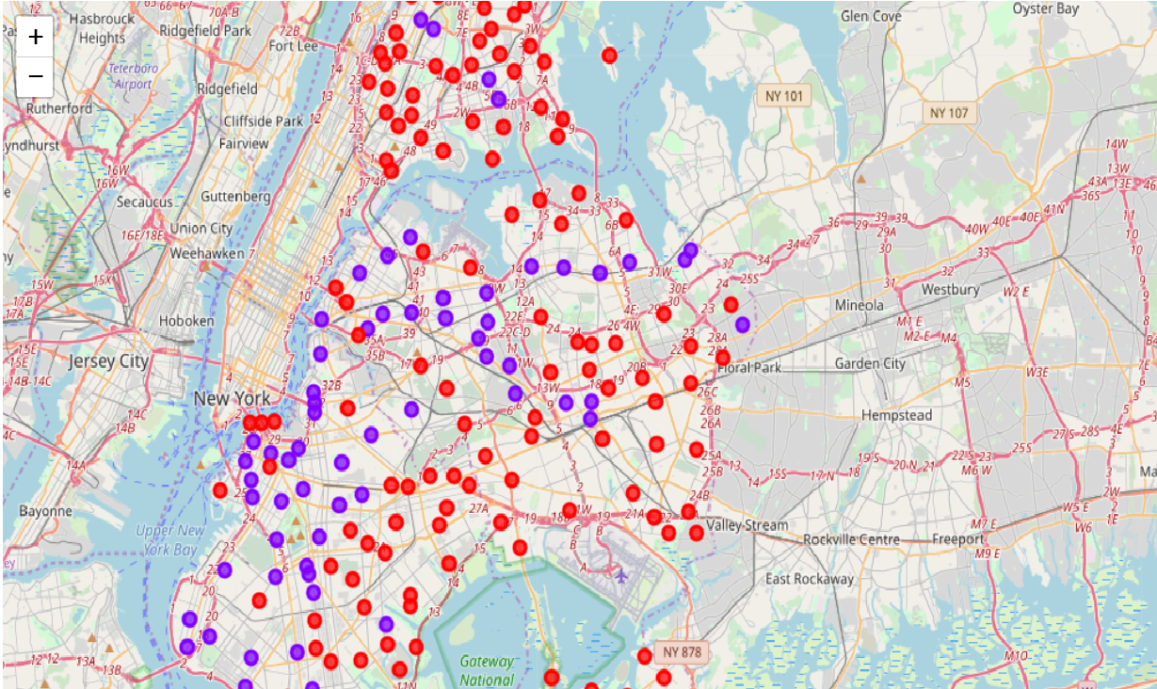
Results (Bronx, Brooklyn and Queens)
Segmenting and Clustering Neighborhoods
Cluster0 : The Total and Total Sum of cluster0 has smallest value. It shows that the market is not saturated. There are untapped markets.
Cluster1 : The Total and Total Sum is very high. Lot of competition. Saturated neighborhoods.

Slide 21
Conclusion
Analysis performed on limited data
Re-run program with updated information
Brooklyn and Manhattan has high concentration of restaurant business. Very competitive market.
Bronx, Queens and Brooklyn also has good number of restaurants but not as many as required. So this can be explored.
As per the neighborhood or restaurant type mentioned like Indian Restaurant, analysis can be checked. A venue with lowest risk and competition can be identified

